Slide 1
Novel AI Input Support Tool for android. (ver.34)
新たな入力支援ツールが登場！
[Novel AI Input Support Tool]
Novel AI Input Support Tool

Slide 2
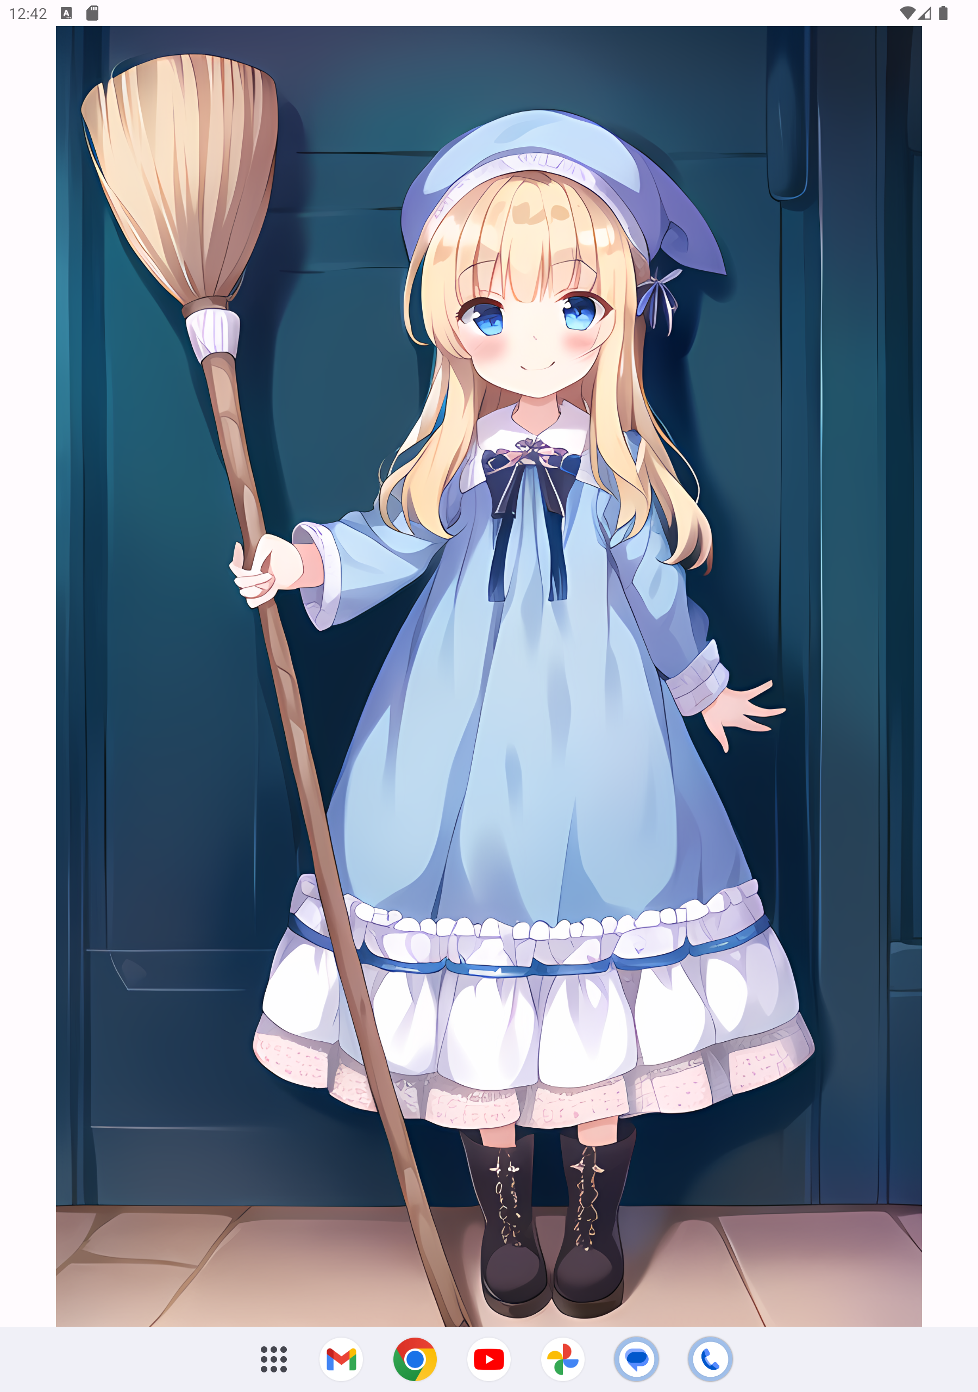
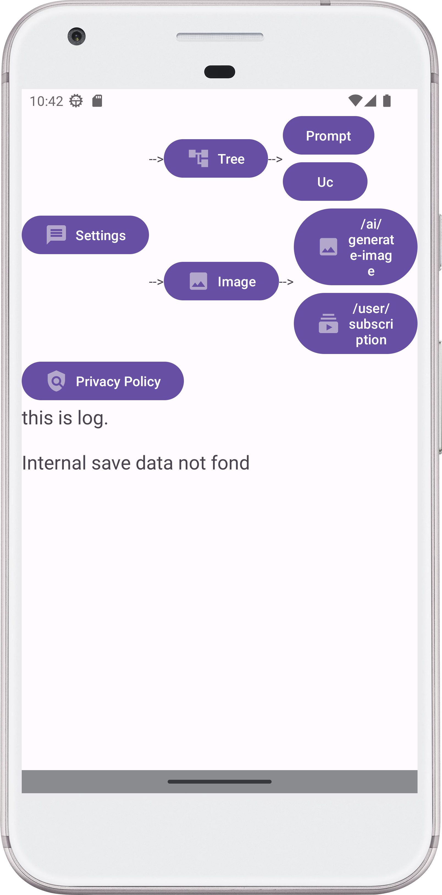
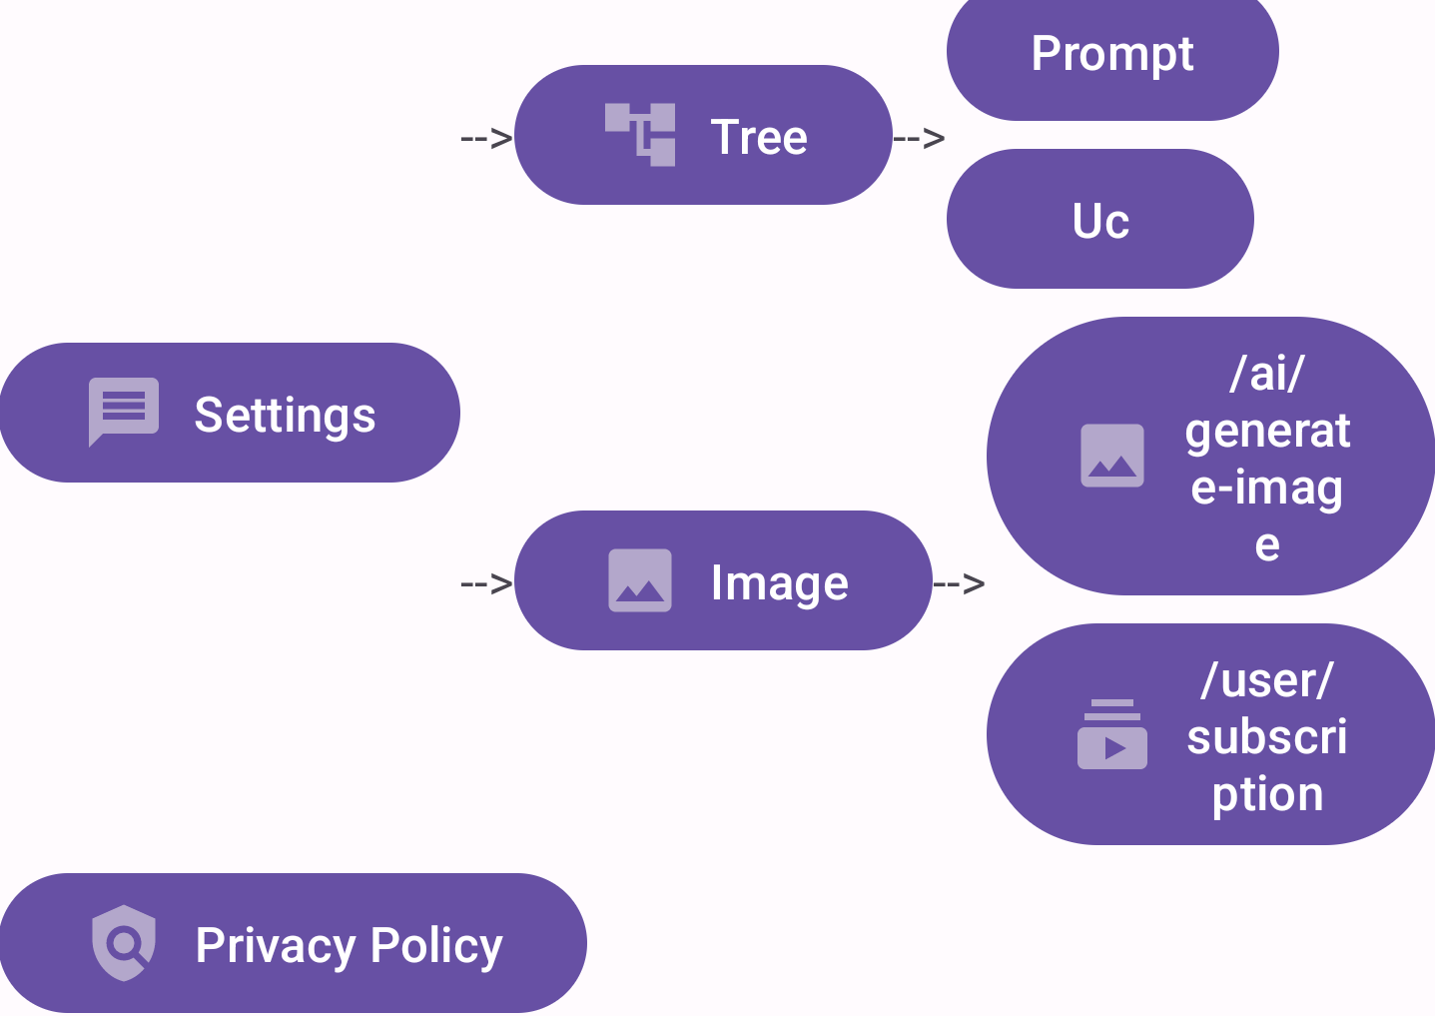
What is this?
One Point
Create image used by Novel AI REST API

Slide 3




Solution (1/2)
Before
After
Think Prompt Every Time
Random Prompt Every Time
Decision tree data
Save
FTP
look at
look at
Bothersome
I have a dream that operated with only left hand by Novel AI.
One Point
Many images can be viewed with just a tablet. Yes, we can!

Slide 4
Solution (2/2)
Before
After
Select every time
by decision tree
User input every time
33% maid
33% gym uniform
33% school uniform
1gurl
pink hair
maid
…
look at
look at
Bothersome
I have a dream that operated with only left hand by Novel AI.
One Point
Prepare a decision tree, and generate your favorite image

Slide 5
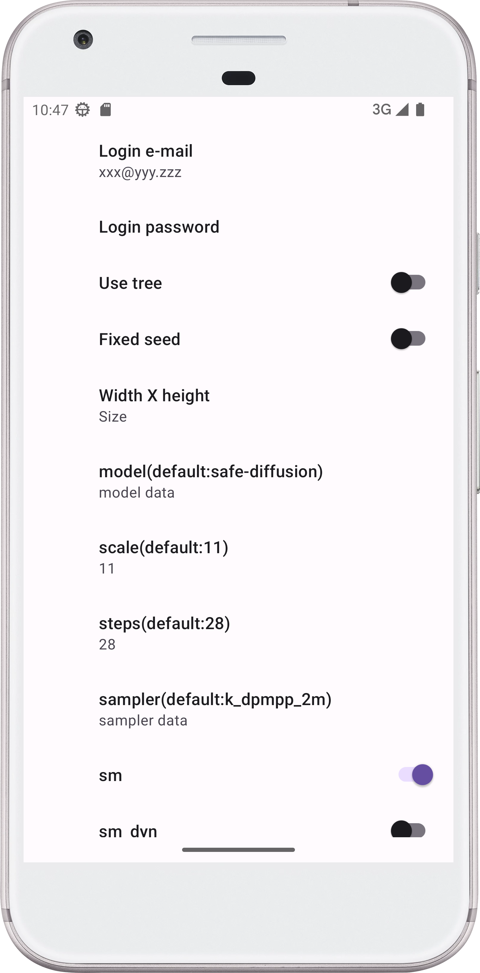
Function introduction /Settings
Require
Novel AI account
and password
https://novelai.net/

Slide 6
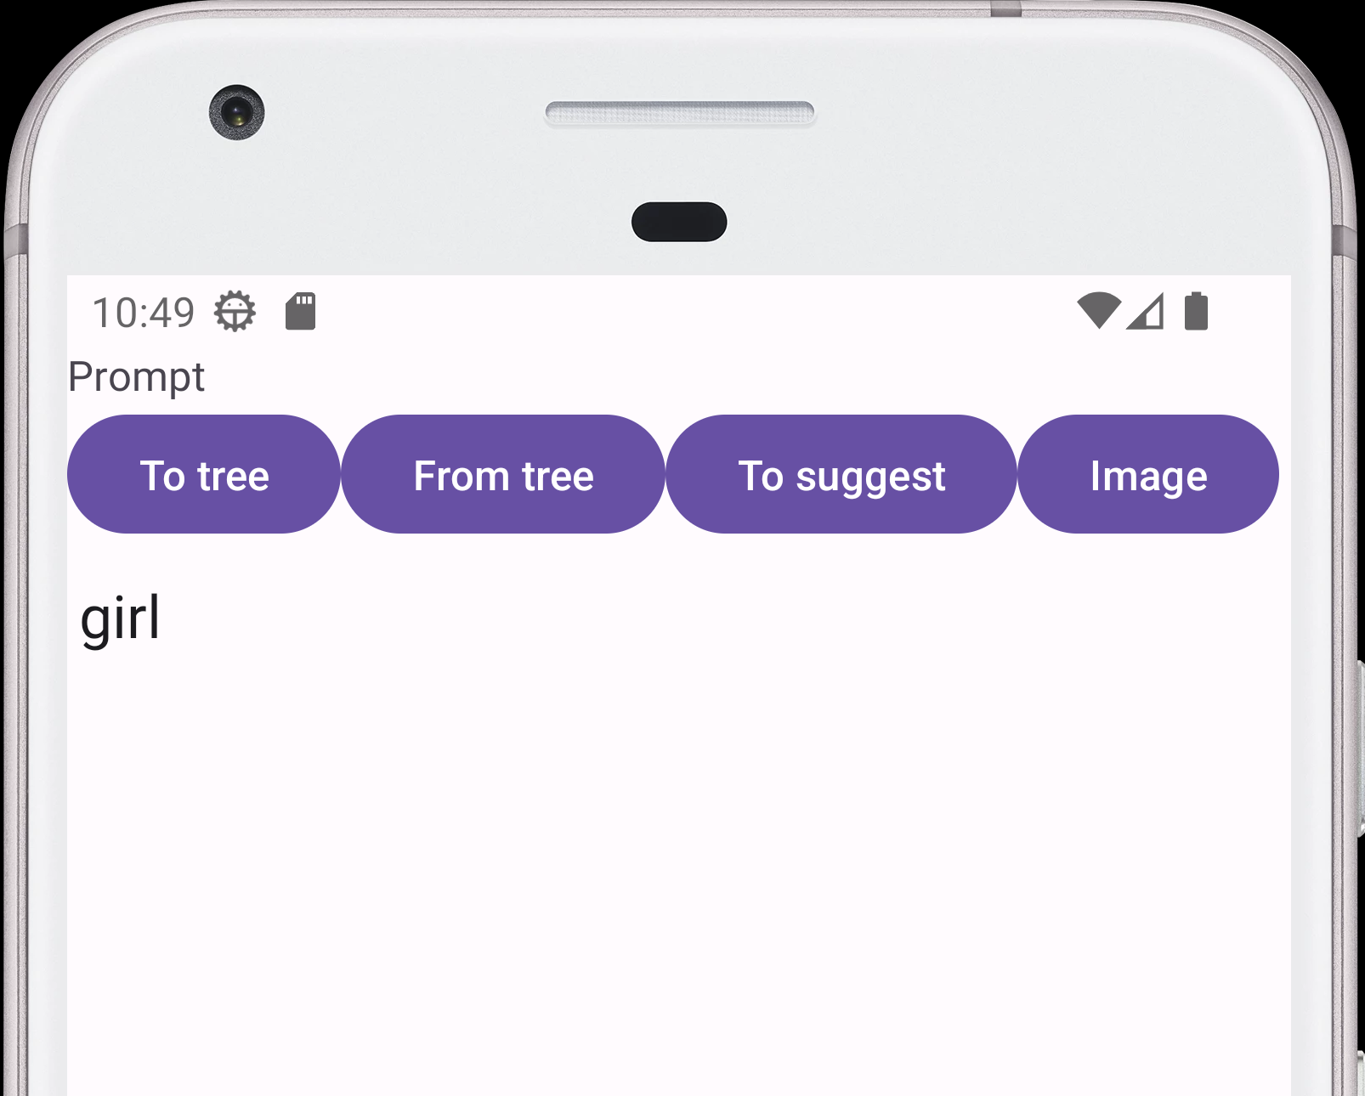
Function introduction /Prompt or Uc
Go to Image
Send to tree
Send from tree
Go to Suggest
(Next page)

Slide 7
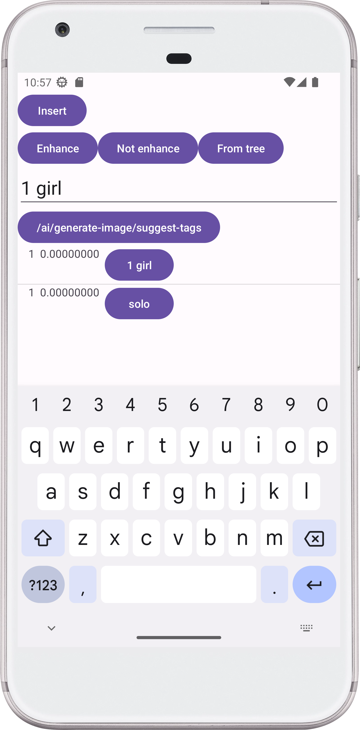
Function introduction /Suggest
Insert word
Input message
Suggest
List of Suggest

Slide 8
Function introduction/Tree / Transform
{{{NSFW}}}
Enhance
NSFW
[[[NSFW]]]
Not Enhance

Slide 9
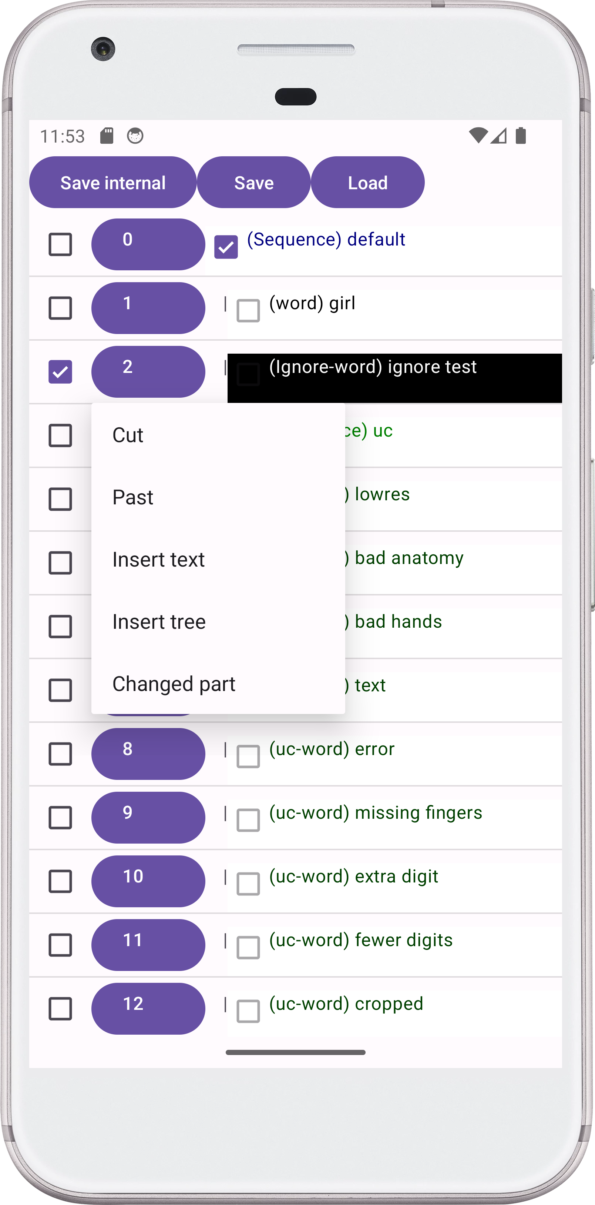
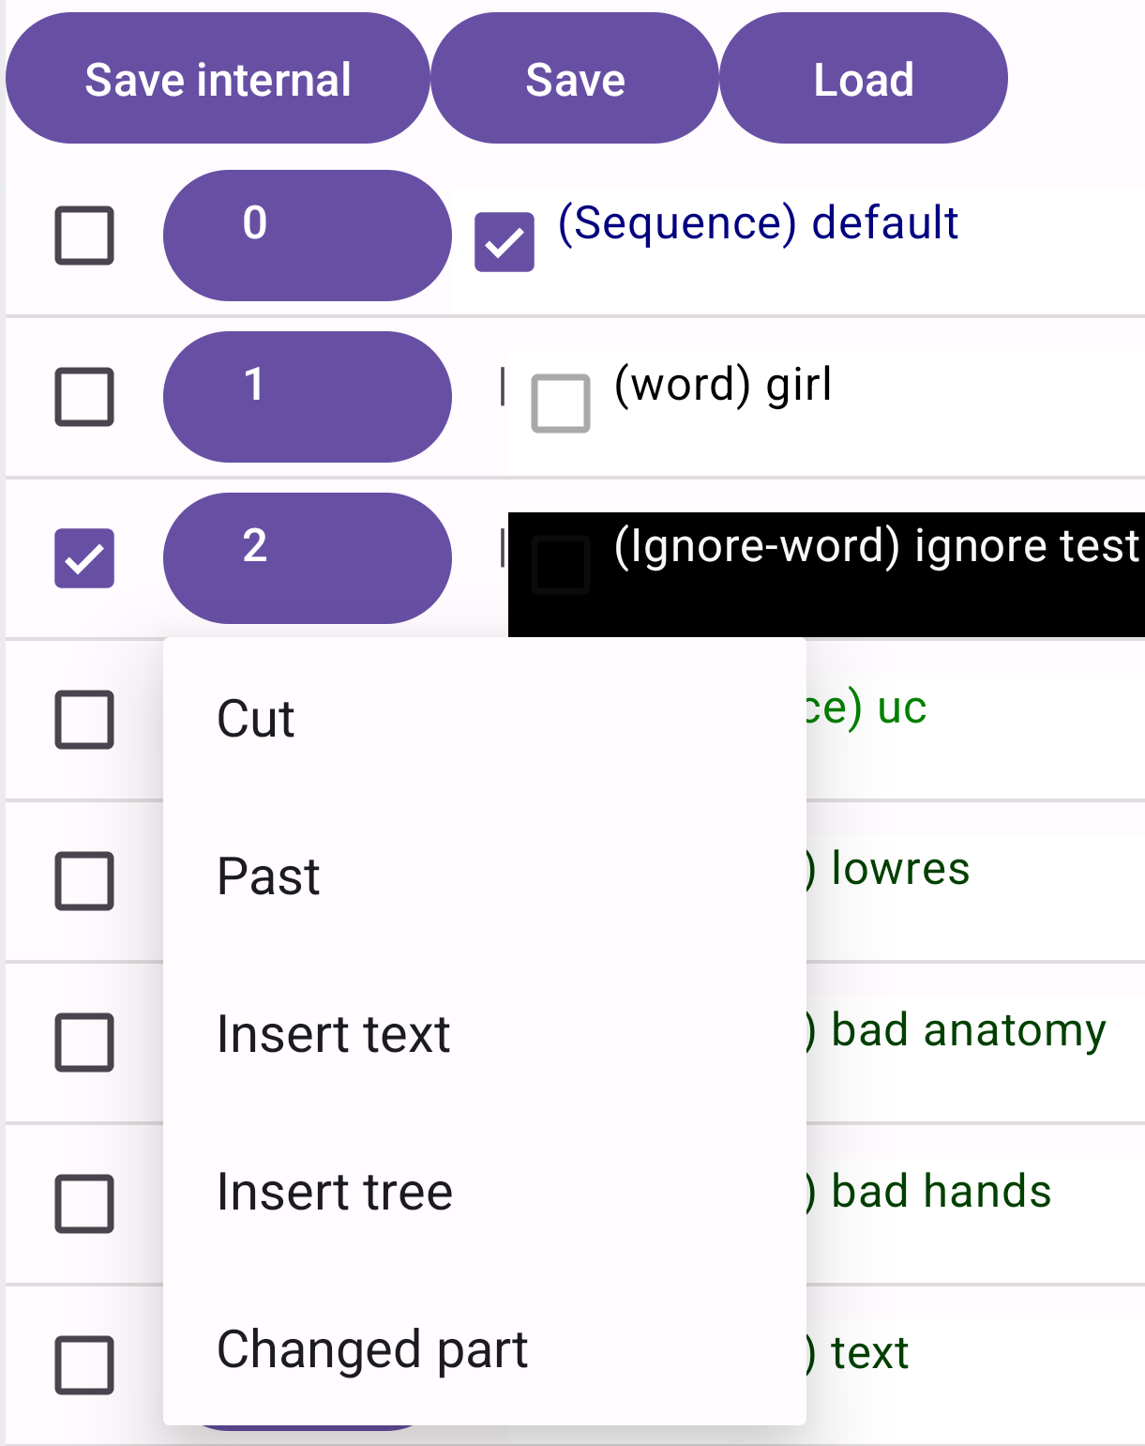
Function introduction/Tree
Save
Load

Slide 10
Function introduction/Tree
Expand/collapse tree
Prompt data tree
Ignore button
Ignore data
Sub menu button
Uc data tree
Sub menu

Slide 11
Function introduction/Tree/Sub menu
Cut tree
Past tree

Slide 12
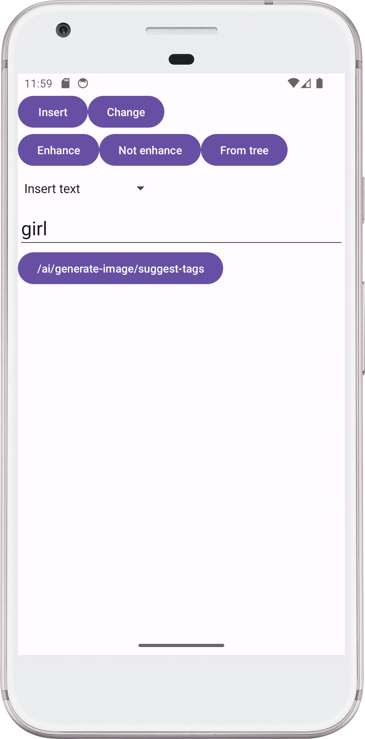
Function introduction /Tree/Sub menu
Insert text

Slide 13
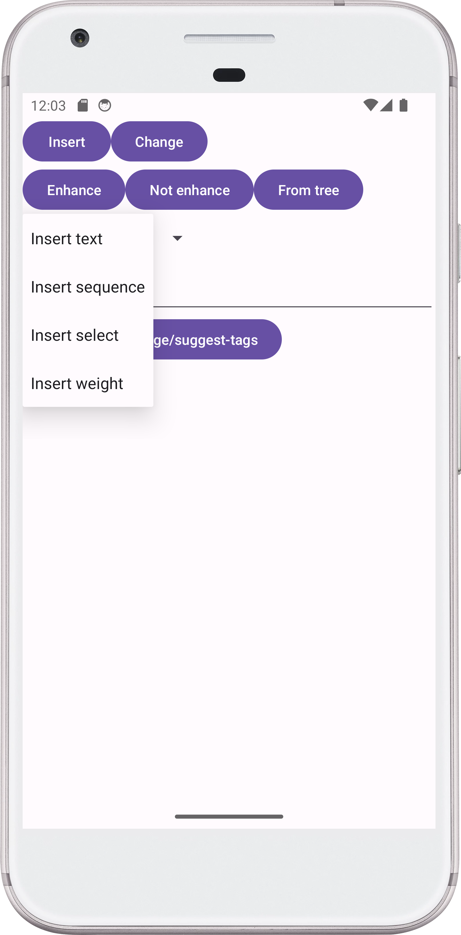
Function introduction /Tree/Sub menu
Insert or change Tree
Next page

Slide 14
Function introduction/Tree / Insert tree
Sequence
- Sequence
- aaa
- bbb
- ccc
Example
Send all
aaa, bbb, ccc
Select
Example
- Sequence
- aaa
- bbb
- ccc
aaa
33%
Send only one with equal probability
bbb
33%
ccc
33%
Weight
- Weight
- aaa
- bbb
- ccc
Example
Send only one with first probability
aaa
60%
bbb
24%
ccc
16%

Slide 15
Function introduction/ Image

Slide 16
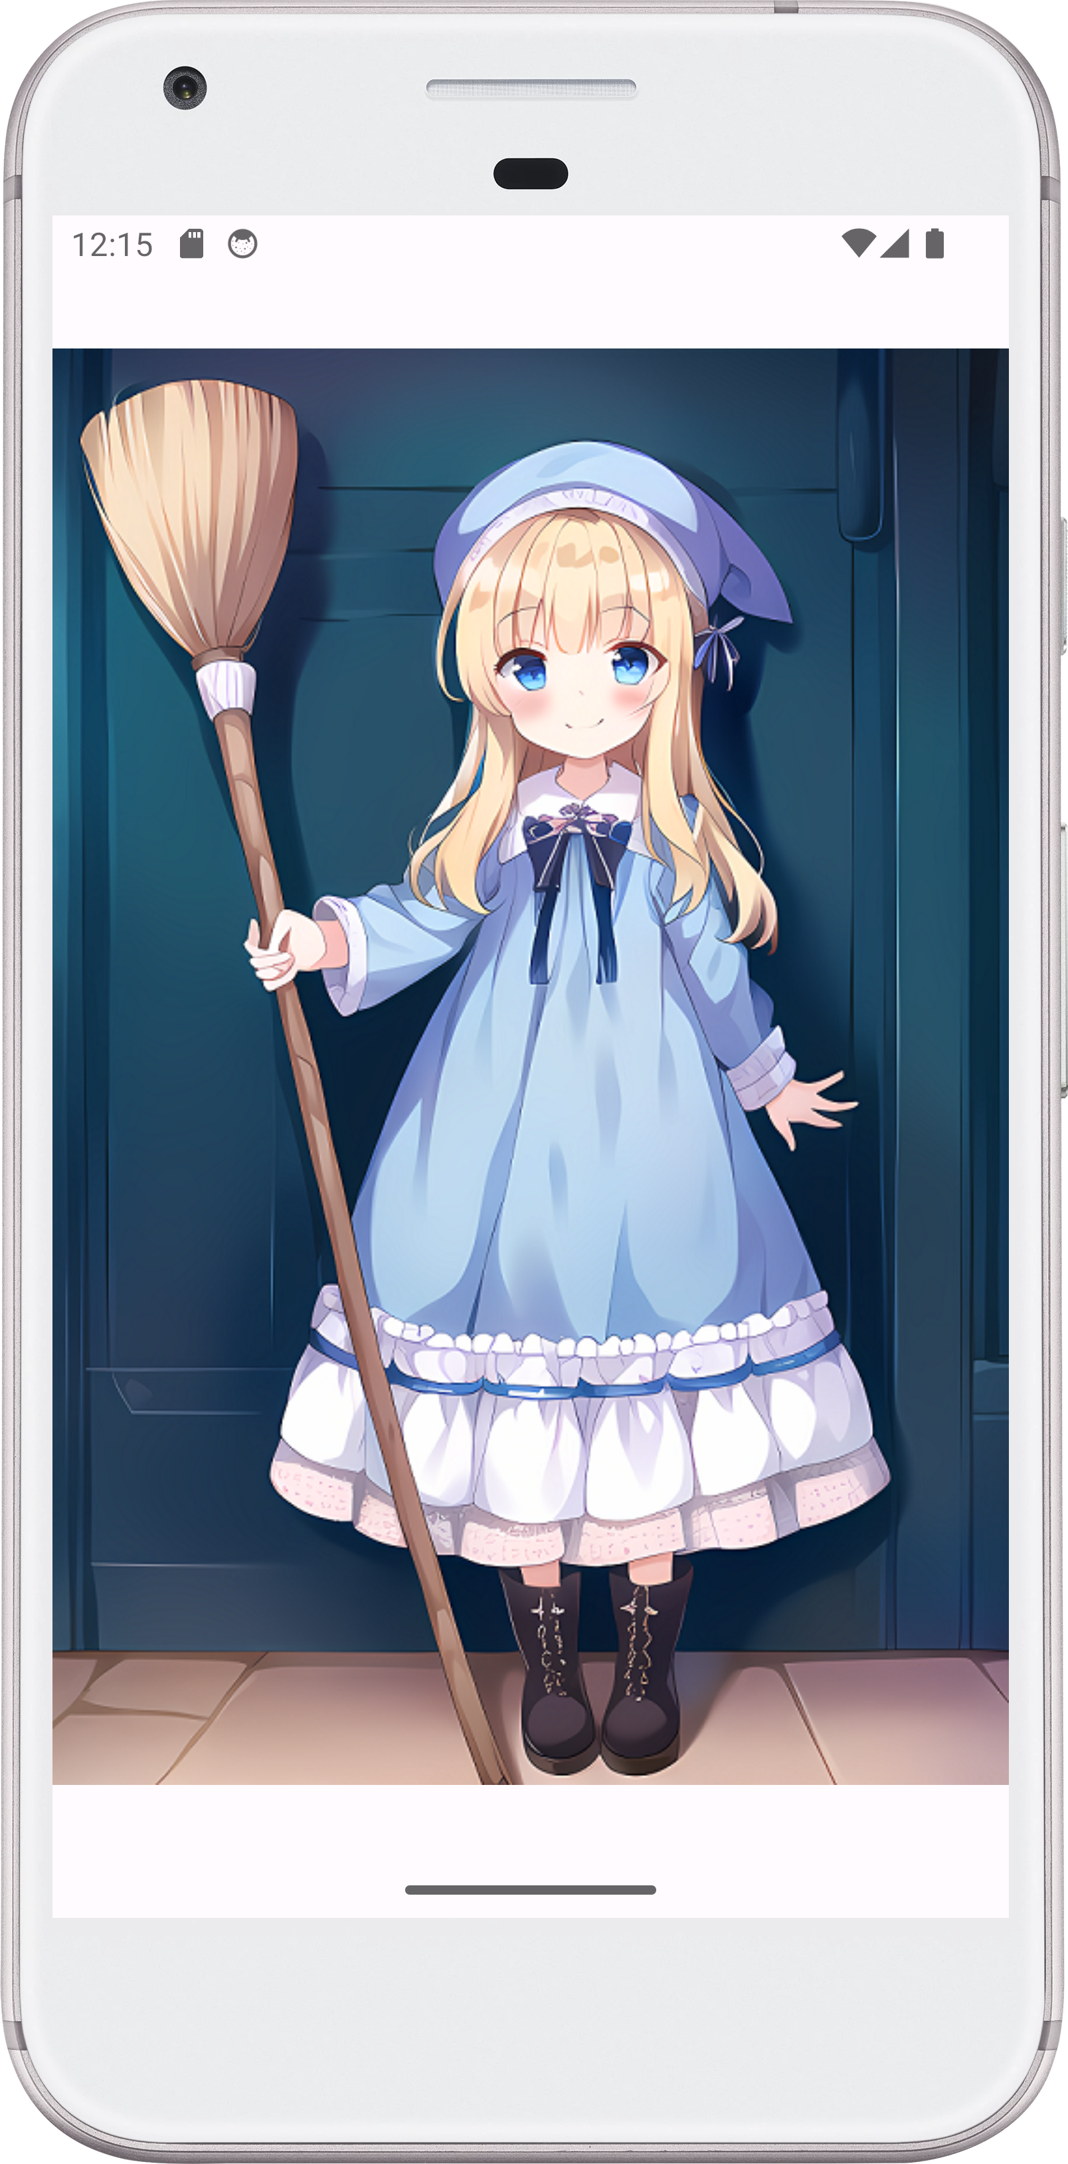
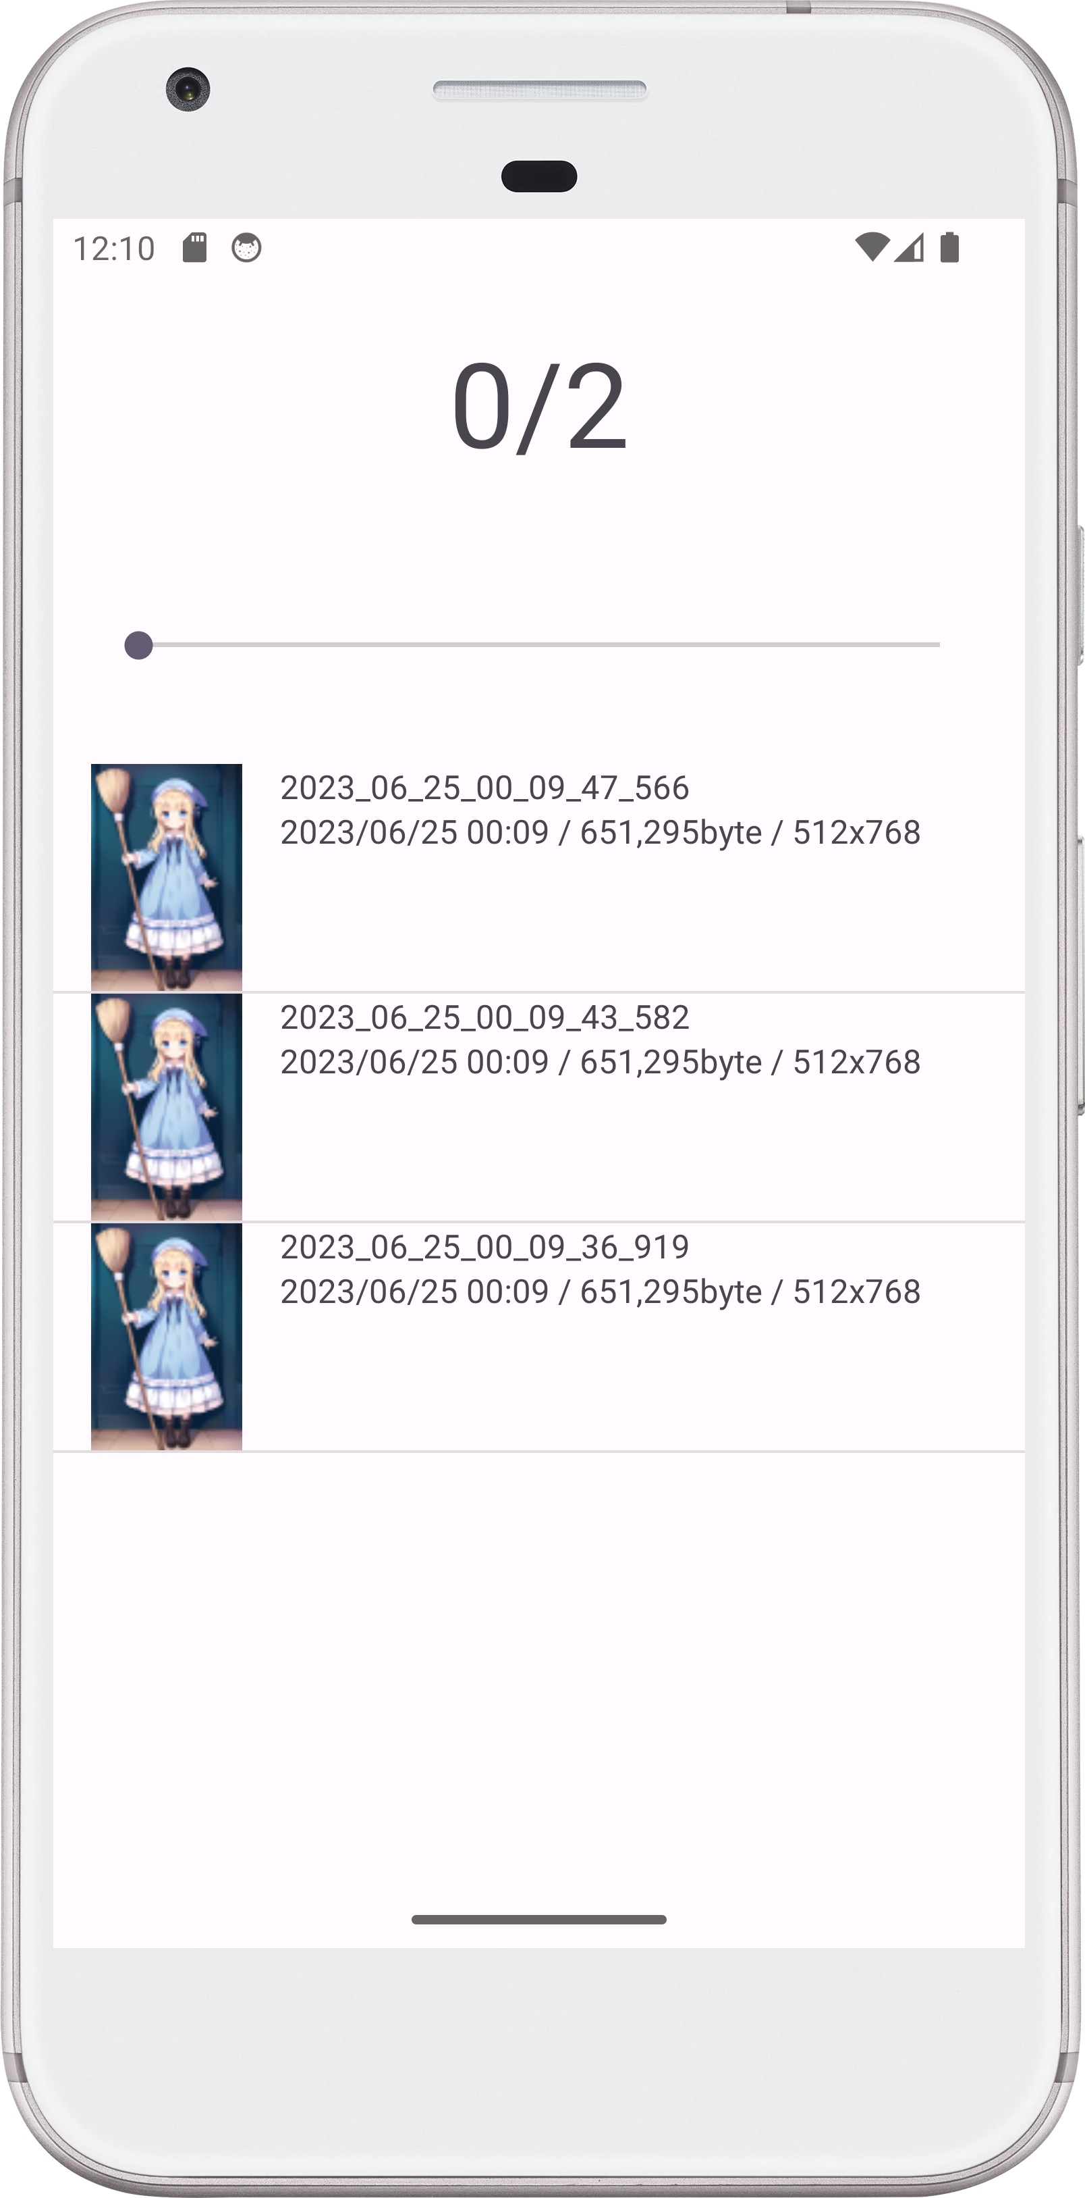
Function introduction/ Image
Swipe down
Display list of images.
Swipe left: preview
Swipe right: next

Slide 17
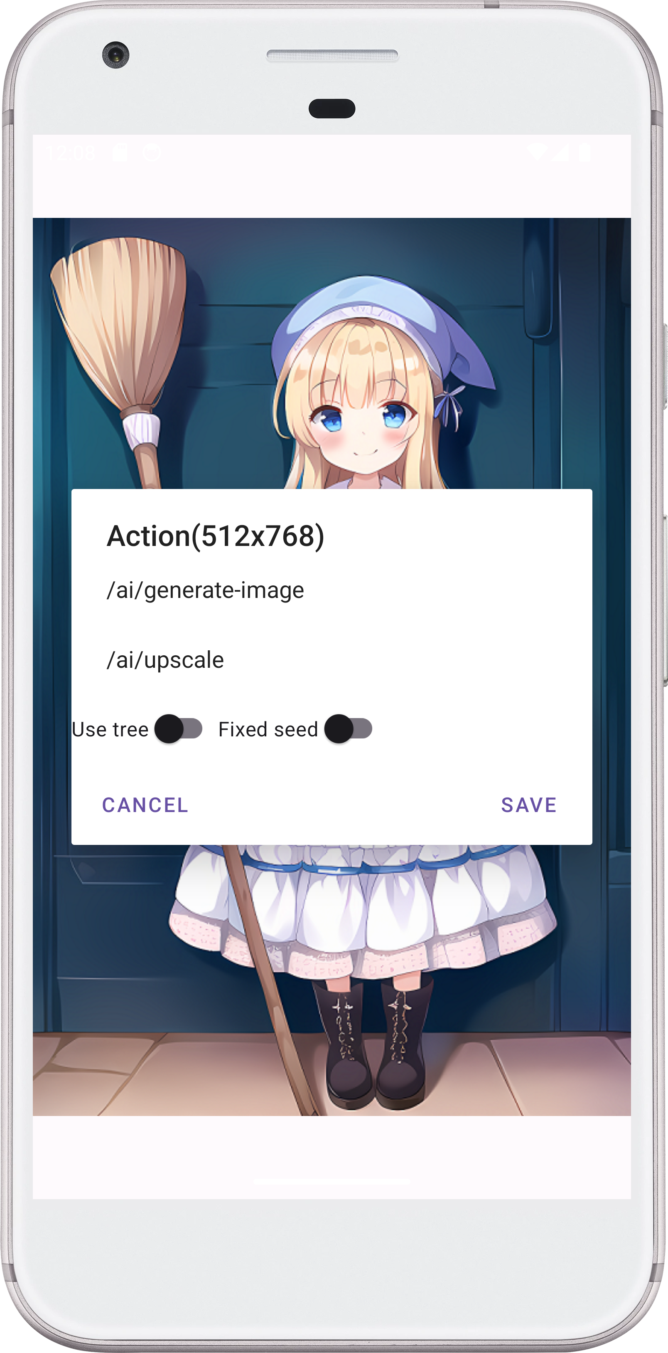
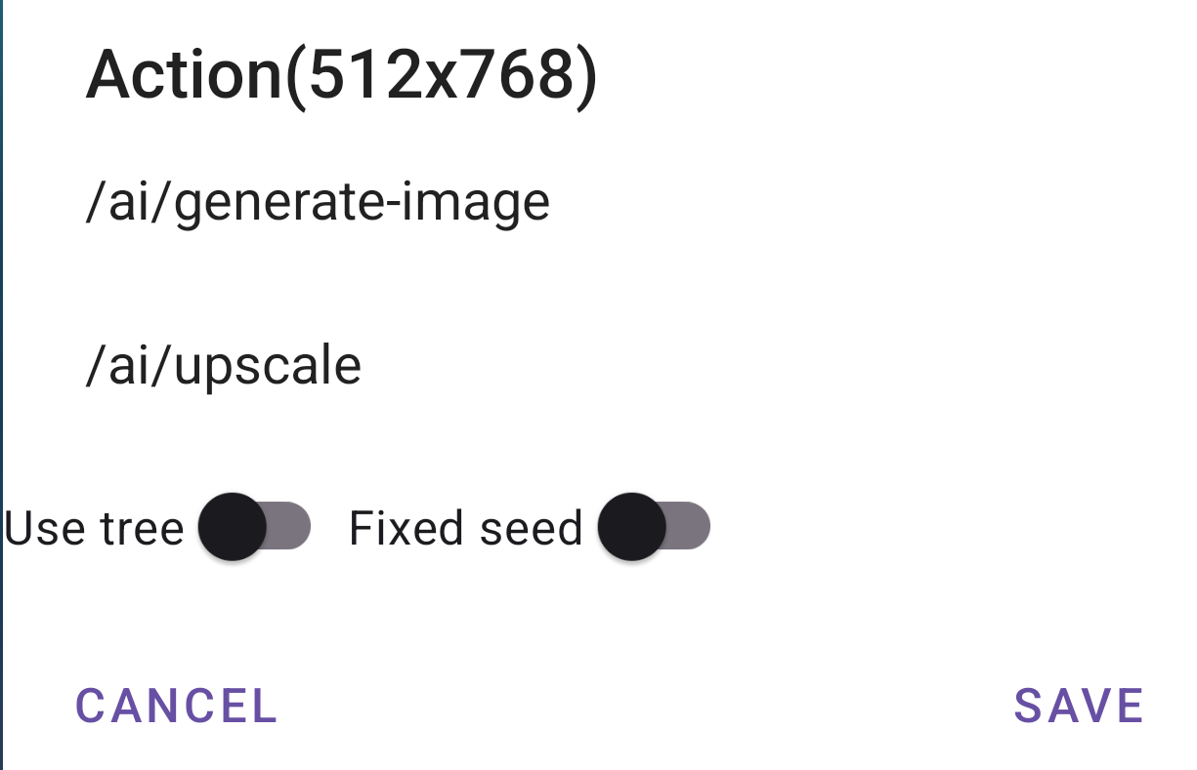
Function introduction/ Image
Re: Generate
look at
Upscale
Save
Cancel

Slide 18
Enjoy!
・To be continued.
One Point
そのとき、ふとひらめいた！
この経験は〇〇な画像の作成に活かせるかもしれない。

